Slide 1
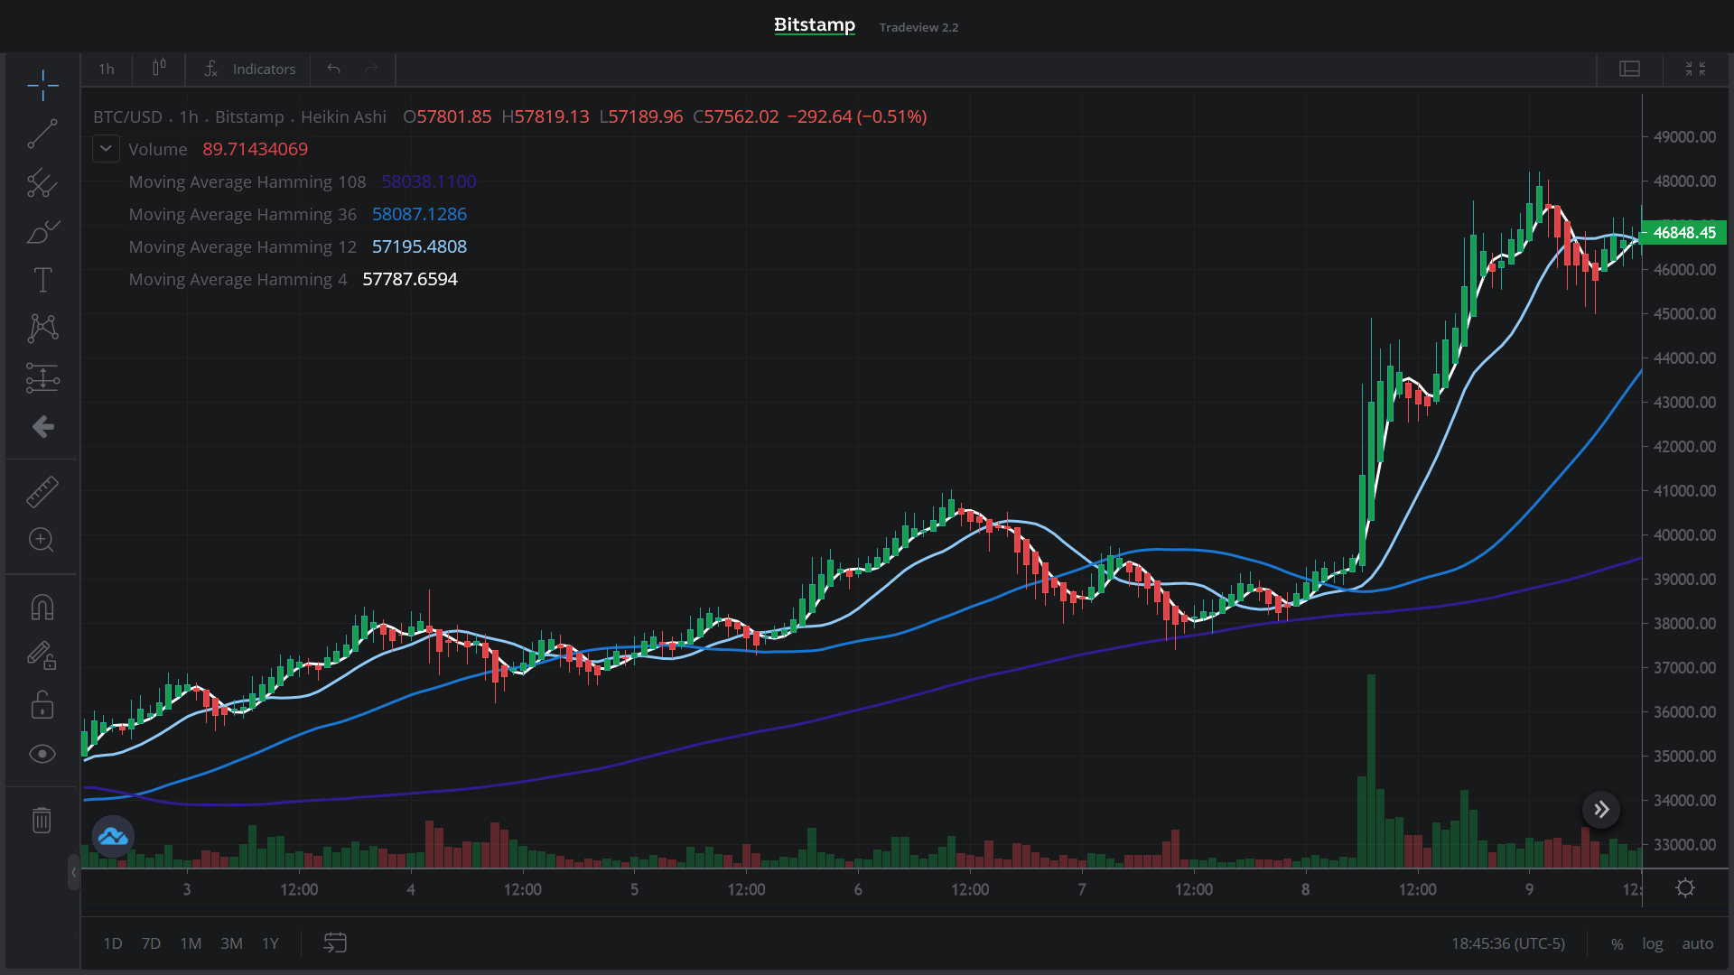
Deep Learning
Cryptocurrency Market Analysis
March 22, 2021
Lead Investigator - Scott Qualkenbush

Slide 2
Overview
Trading positions in financial markets can be very difficult. There is a steep learning curve for individuals who want to get involved with trading in these markets. Also, there is a high risk of losing your money just as there is in making money. However, if your trading decisions are the well informed then you stand to make a significant amount of money.

Slide 3
Overview
There are countless numerical and graphical methods of analysing financial markets to better understand what it will probably end up doing; these are predictive analysis techniques. Machine learning and deep learning have already been applied to this task of making predictive analysis. However, using image classification through deep learning of the market activity plots themselves is an underdeveloped application in this field.

Slide 4
Overview
Using deep learning on a financial market activity plot images has great potential to produce valuable predictive results that few, if any, individuals or organizations are taking advantage of as this new technology is developed.
A key part of proceeding with a successful analysis starts with setting up a market viewer with the most expressive price movement representations. Such as choosing, bin width, time scale, image overlap, using candlesticks or simple lines, along with over layed metrics such as moving averages or any other of the dozens of indicators that may be viewed on or along with a activity plot.

Slide 5
Overview
For my analysis I take a series of images and train an Convolutional Neural Network to look at one 7-day image and predict if in the next image days price movement will result in an overall average positive, neutral, or negative price movement.

Slide 6
Overview
Full Image Data

Slide 7
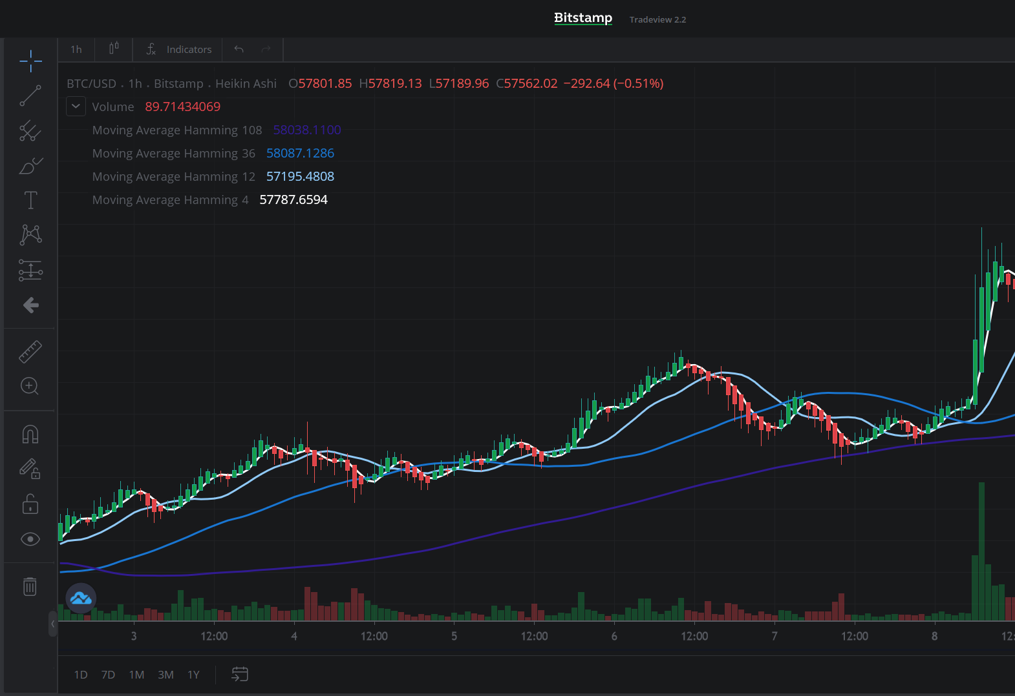
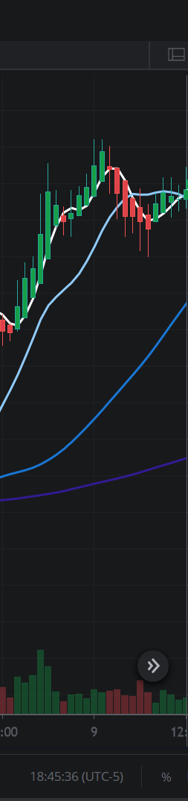
Overview
Create training and test sets
→ +
Training Test

Slide 8
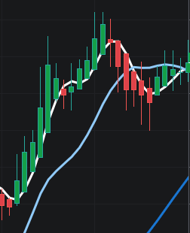
Overview
Evaluate test images by assigning them as Gain, Neutral, or Loss by summing the green and red pixels that the candlesticks are made of and computing a ratio for the image.
If the ratio is close to 1.0, then the classification is Neutral. Higher ratios will count as Gain, while lower ratios will count as Loss.
Test Image Candlesticks

Slide 9
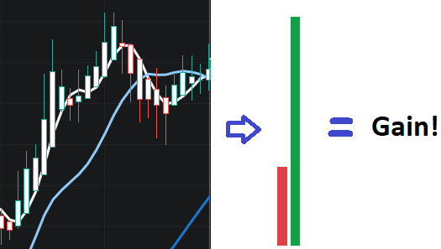
Overview
Example:

Slide 10
The Data
Name: Bitcoin Tradeview Images from Bitstamp
Procurement: Developed a scraper to scroll across the chart and take images.
Description: Initial image set: Images of a 7 day trading period with Heikin Ashi Candlestick trading activity representation with 1 hr bin widths. Also included is a trading volume metric and Hamming Moving Averages for periods of 4 hrs, 12 hrs, and 36 hours.
Total Number of Images: 3300
Source: https://www.bitstamp.net/market/tradeview

Slide 11
Analysis Step 1:
Prepare Data

Slide 12
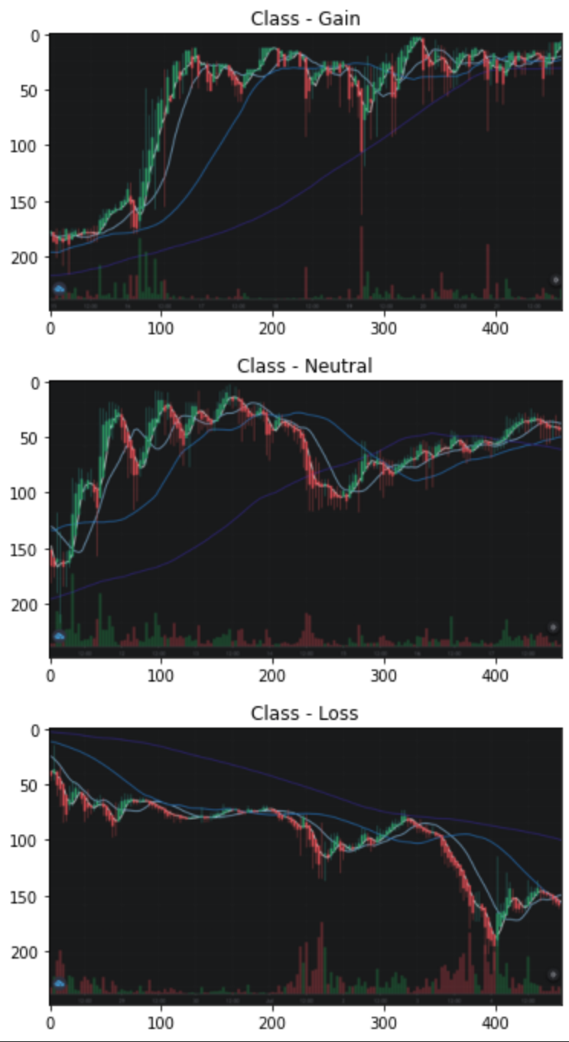
Preparing The Data
After classifying images:
Gains: 1080, 32.3%
Neutrals: 1429, 43.4%
Losses: 790, 26.3%
After train_test_split:
Training set: 2779
, 84.2%
Validation set : 520, 15.8%

Slide 13
Analysis Step 2:
Modeling

Slide 14
Modeling - CNN
CNN Architecture:
Conv2D - Activation(relu)
Maxpooling2D
Conv2D - Activation(relu)
Maxpooling2D
Conv2D - Activation(relu)
Maxpooling2D
Conv2D - Activation(relu)
Maxpooling2D
Dropout
Flatten
Dense - Activation(relu)
Dropout
Dense - Activation(softmax)
For the first leg of the project, I will be using a Convolutional Neural Network with a sequential API.
Parameters: 859,359
Batch_size: 16
Epochs: 20
Run time: 7 minutes

Slide 15
Modeling - Xception
For the second leg of the project, I will be using a pre-trained deep learning model trained on ImageNet and can be found in Keras Applications .
Parameters: 20,867,627
Batch_size: 16
Epochs: 20
Run time: 45 minutes
Keras Applications - https://keras.io/api/applications/
Xception - https://keras.io/api/applications/xception/
Definition - Deep Learning with Depthwise Separable Convolutions

Slide 16
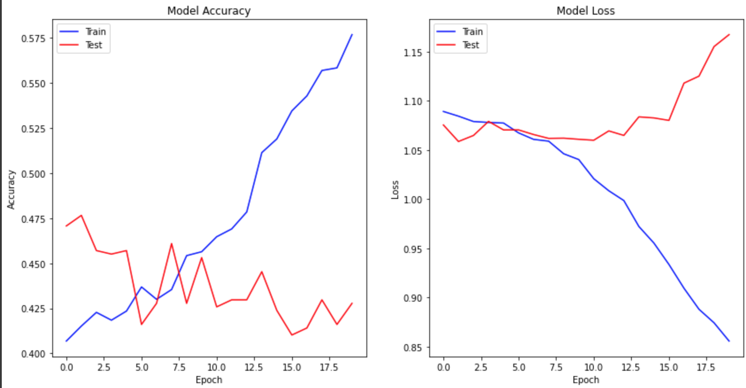
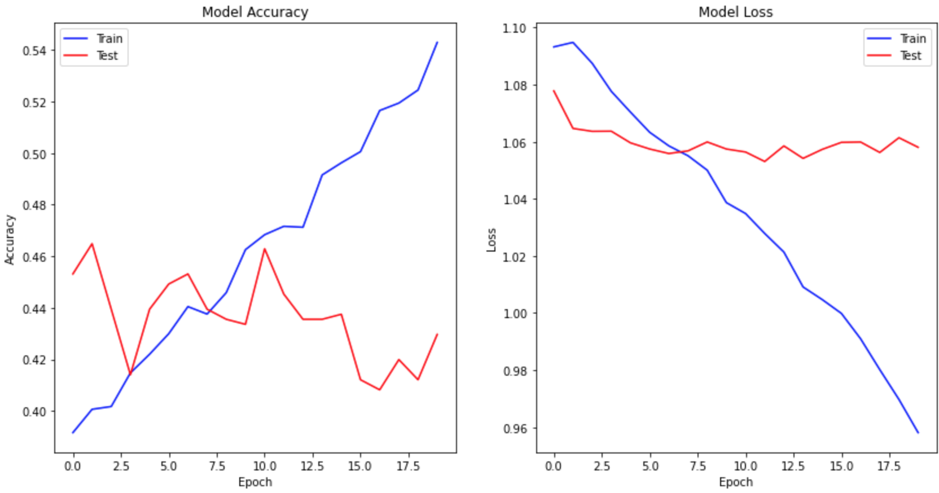
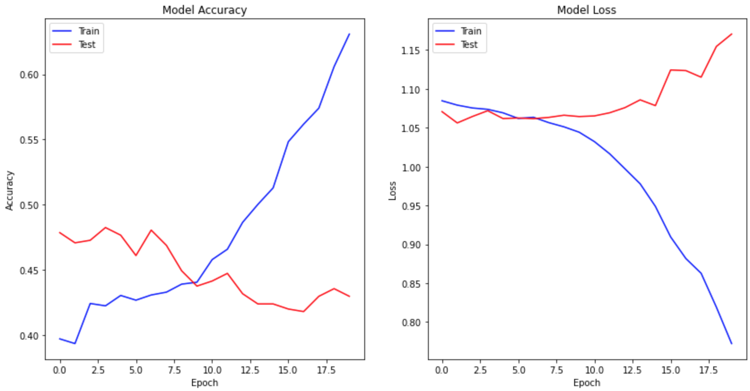
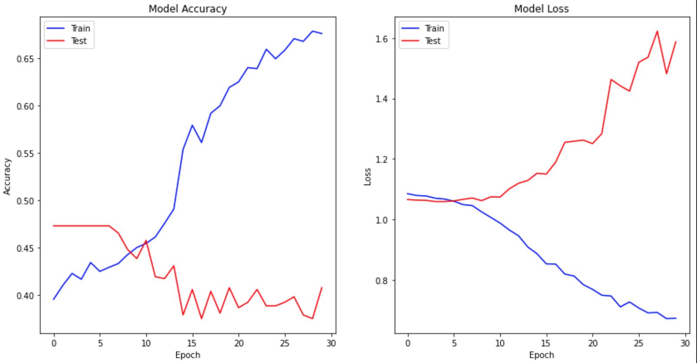
Modeling - Tuning

Slide 17
Analysis Step 3:
Post-Hoc Review

Slide 18
CNN Model Evaluation
Model Accuracy
Training Accuracy
Testing Accuracy
Model Loss
Training Loss
Testing Loss

Slide 19
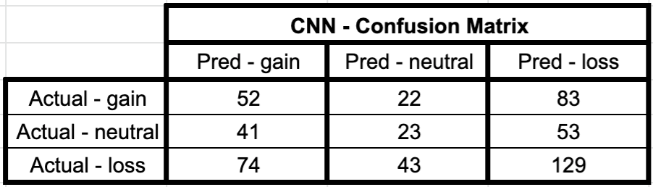
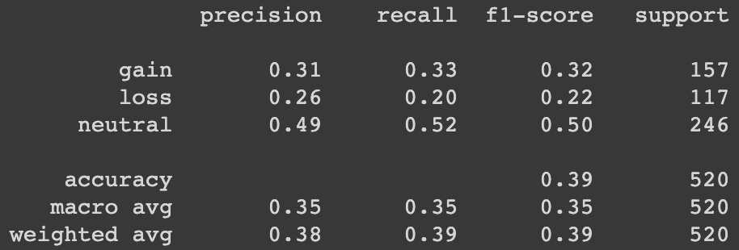
CNN Model Evaluation
Confusion Matrix
CNN - Classification Report
Classification Report

Slide 20
Xception Model Evaluation
Model Accuracy
Training Accuracy
Testing Accuracy
Model Loss
Training Loss
Testing Loss

Slide 21
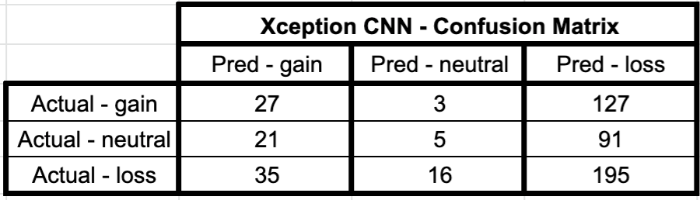
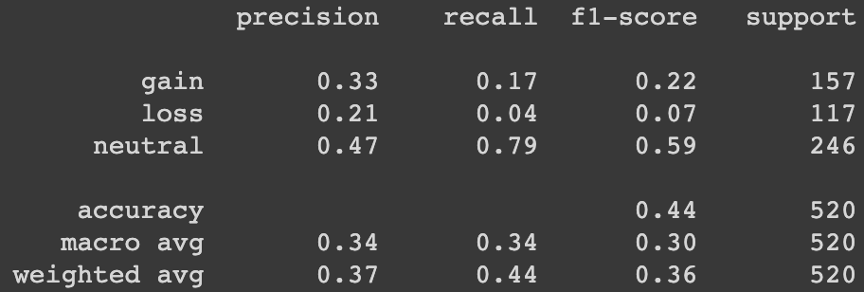
Xception Model Evaluation
Confusion Matrix
CNN - Classification Report
Classification Report

Slide 22
Side-by-side Model Evaluation
Model 1: Simple CNN Model 2: Xception Pre Trained CNN

Slide 23
Conclusion and Recommendations
Conclusion
Initial Goal: Build a convolutional neural networks to predict if the 8th day price movement
Although there is some ability to predict the test set correctly, it' has only a slightly better chance of being correct than simply predicting the most likely outcome; which is loss, at 43.4%. The best performing simple CNN model scored: Test loss = 1.1721, Test accuracy = 0.04289. While the best performing model produced with the Xception pretrain scored: Test loss = 1.0584, Test accuracy = 0.04288.
Quantitative evaluation metrics show the simple CNN scored better in ⅔ of the following categories: precision, recall, and F1 scores. Winner! Kinda.

Slide 24
Conclusion and Recommendations
Conclusion
Initial Goal: Build a convolutional neural networks to predict if the 8th day price movement. Deploy on Markets, create subscriptable service, sell to firm.
Although there is some ability to predict the test set correctly, it' has only a slightly better chance of being correct than simply predicting the most likely outcome; which is loss, at 43.4%. The best performing simple CNN model scored: Test loss = 1.1721, Test accuracy = 0.04289. While the best performing model produced with the Xception pretrain scored: Test loss = 1.0584, Test accuracy = 0.04288.
Quantitative evaluation metrics show the simple CNN scored better in ⅔ of the following categories: precision, recall, and F1 scores. Winner! Kinda.
Recommendations
- The primary recommendation I would have for conducting further analysis on this topic would be to collect much more image data. Market activity image data can be collected from additional exchanges and market watching websites.
- Another additional feature to play with would be to investigate trying to overlay the image sets with more useful analysis metrics; The Bitstamp Tradeview has dozens of different metrics to apply to the graph.
- Additionally, the CNN model could use more optimization than time allowed for in this capstone. The model architecture could always use further optimization, as well as the hyperparameters.

Slide 25
Thank You

Slide 26
Questions?

